Slide 1
The Raindance Patent
Photonic Integrated Circuit (PIC) Chip based Wavelength Meter Device Technologies for Telecom and Diagnostics
A Patent Acquisition
Opportunity
Disclaimer – The information contained in the following pages is provided in connection with an offer for sale of the referenced patent portfolio. The information does not constitute a legal analysis, opinion, or representation or warranty of any kind. The information is provided solely to aid potential acquirers in conducting their own independent evaluation to determine whether to par­ticipate in the sales process conducted by IPinvestments Group. Any statement included in the information regarding the potential use or applicability of any referenced patent or application to specific products or services is provided solely for illustration purposes and shall not be construed as notice of infringement or an accusation of infringement of any of the referenced patents.
This entire document Does not constitute a legal Document, Legal opinion or Legal representation

Slide 2
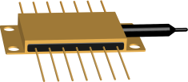



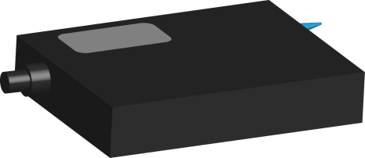

MULTI-WAVELENGTH TRANSMISSION THROUGH ONE OPTICAL FIBER
Lasers
Modulators
Coupler
Amplifier
1
2

Slide 3

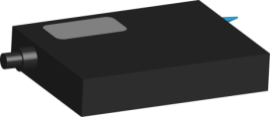

MULTI-WAVELENGTH TRANSMISSION THROUGH ONE OPTICAL FIBER
Salt Lake City,
Utah
Los Angeles, California
2

Slide 4









MULTI-WAVELENGTH TRANSMIITER PHOTONIC INTEGRATED CHIP (PIC)
Optical Fiber
10 mm
InP & InP Related Materials
10 mm
3
4

Slide 5
4

Slide 6
~100 INFINERA CUSTOMERS WORLDWIDE
PIC Tx
PIC Rx
40 Wavelengths
Single Mode Optical Fiber
Software
PIC Tx
Infinera* (INFN) DTN
Av Selling DTN Price $1M
PIC Rx
Software
5
Infinera* (INFN) DTN

Slide 7
CLAIMS 60, 61, 62, 63, 64, 65, 66 OF ‘610 PATENT
6

Slide 8
INDEPENDENT APPARATUS CLAIM 60
A device for measuring the wavelength of an optical signal, device comprising:
an optical processor¹ configured to provide output signals representative of the wavelength of an optical input signal by determining which wavelength subdivision the wavelength is in and what the wavelength is within the wavelength subdivision;
a converter² configured to convert the optical output signals into electronic signals thereof; and
a computational apparatus³ configured to receive electronic signals and to provide a data output representative of the wavelength of the input signals, wherein the input side⁴ of the computational apparatus comprises a plurality⁵ of analog-to-digital converters⁶
7

Slide 9
DEPENDENT APPARATUS CLAIM 61
The device as recited in claim 60, wherein the computational apparatus comprises
an embedded processor.
8

Slide 10
INFRINGING PRODUCT: 8 DLM MODULES WITHIN DTN
BMM MODULE
DLM MODULES
BMM
DLM
9

Slide 11
ONE INFINERA BMM MODULE TO CONNECT W/ MANY INFINERA DLM MODULES
Tx
PIC 1
4:1
BMM
MUX
Tx
PIC 2
Tx
PIC 2
WAVELENGTH
LOCKER MODULE
Tx
PIC 4
CONTROL
ELECTRONICS
10

Slide 12
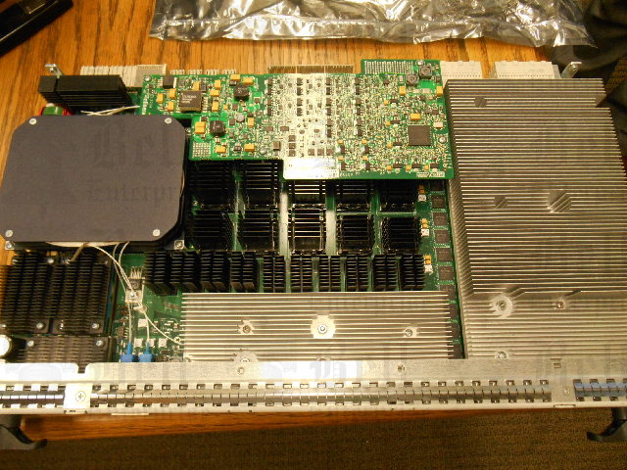
INFINERA DTN-DLM MODULE
C
DISPERSION CONTROL
Underneath
A
PIC
[Underneath
The Heat Sink]
B
WAVELENGTH CONTROL [Underneath
The Heat Sink]
INFINERA DLM-5-C2
PARRT NO. 800-0121-002
11

Slide 13
EVIDENCE FOR APPARATUS CLAIM 60 IN DTN-DLM
1A
HEATER
ISOLATOR
Tunable
AWG
C Or L Or
S Band
BACK
PD
DFB
LASER
EA
SOA
FRONT
PD
OUTPUT TO BMM
VOA
TAP
FPGA
No. 1
SPLITTER
2
TIA
E
1B
TIA
BIAS
CURRENT
+
TM
TIA
SQ WAVE GENERATOR
FPWL SUB MODULE
DSP
FPGA
No. 2
DAC
3
4
5
ADC
6
12
RED => DLM

Slide 14
EVIDENCE FOR APPARATUS CLAIM 60 IN DTN-DLM WITH TUNABLE FILTER
1A
HEATER
ISOLATOR
Tunable
AWG
C Or L Or
S Band
BACK
PD
DFB
LASER
EA
SOA
FRONT
PD
VOA
OUTPUT TO BMM
TAP
TF
FPGA
No. 1
SPLITTER
2
TIA
E
1B
TIA
BIAS
CURRENT
+
TM
TIA
SQ WAVE GENERATOR
FPWL SUB MODULE
DSP
FPGA
No. 2
DAC
3
4
5
ADC
6
13
RED => DLM

Slide 15
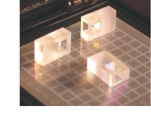

EVIDENCE FOR “ELEMENT 1-OPTICAL PROCESSOR” IN APPARATUS CLAIM 60
3 INDIVIDUAL ETALONS
ETALON
1B
+
C-BAND AWG
L-BAND AWG
S-BAND AWG
1A
14
Notes:
++

